Slide 1
Book1
File created on: 5/13/19 6:02:10 PM EDT

Slide 2
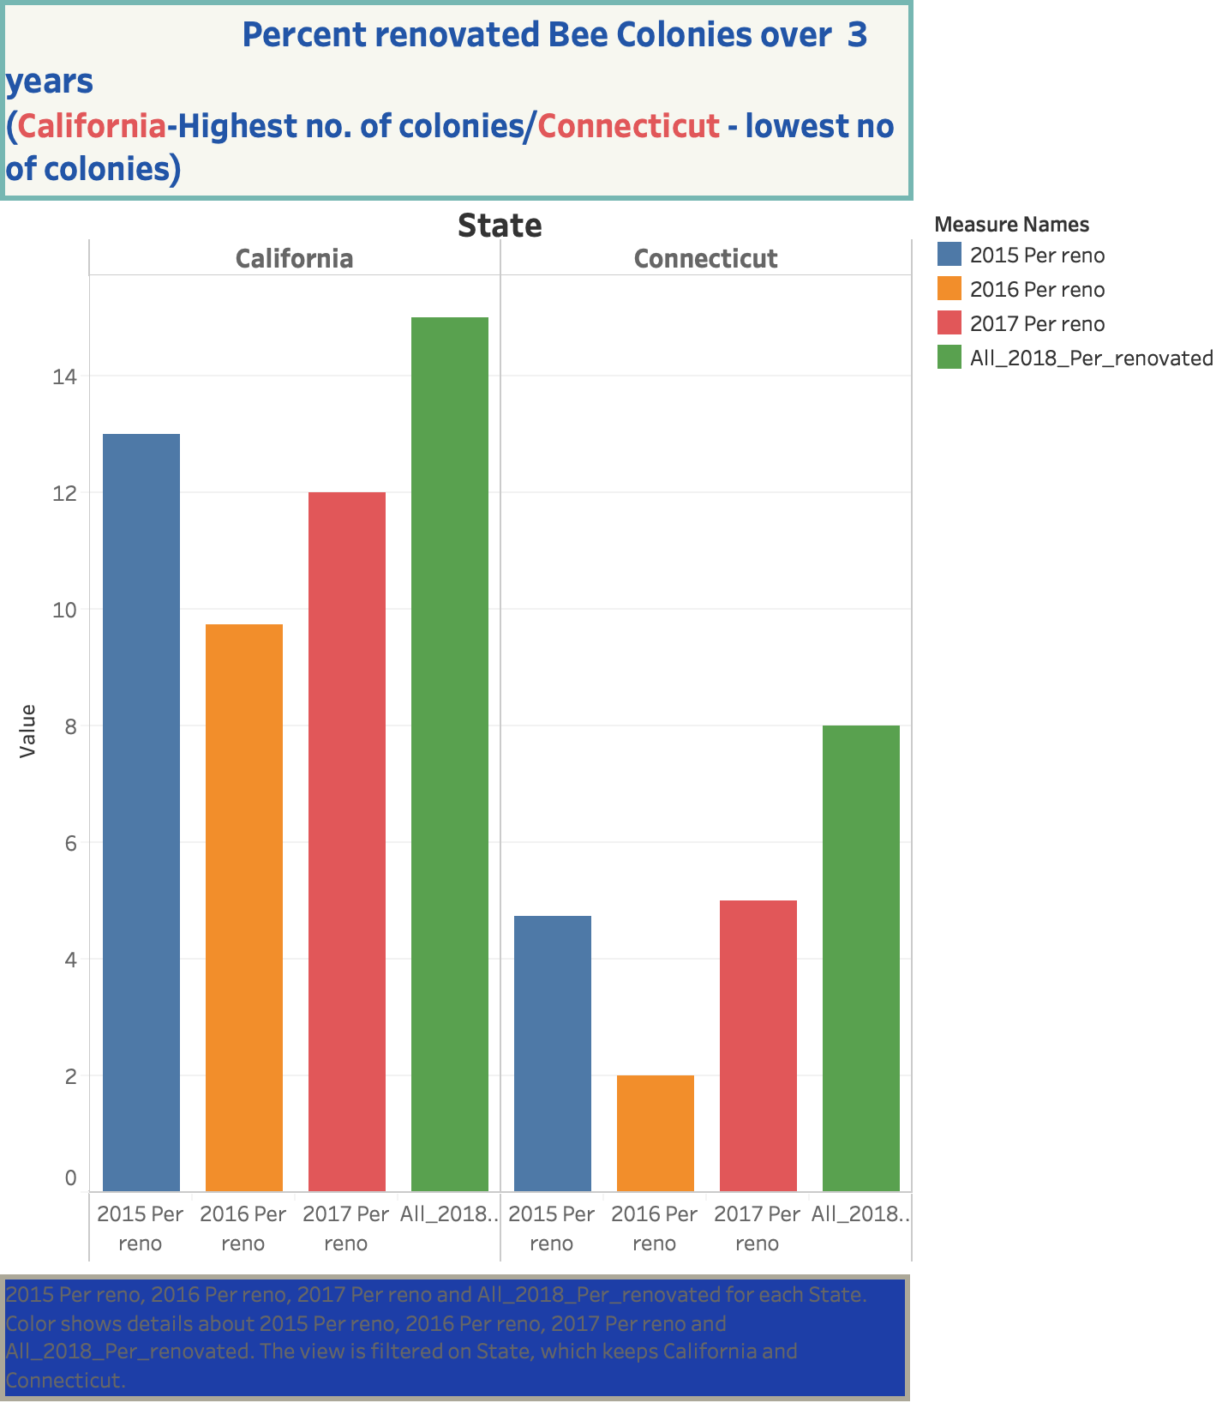

Slide 3
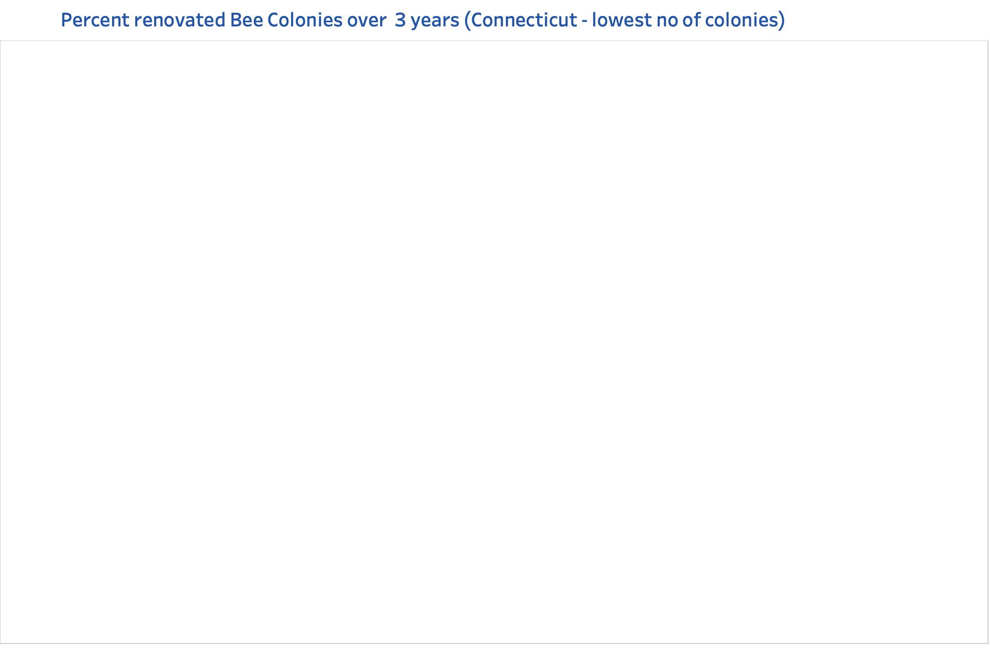

Slide 4
